Slide 1
Community ownership of RE in Ringkøbing-Skjern Municipality and the framework
West Jutland Energy and Environment Association
Alliancen for Community Power in Denmark

Slide 2
Henning Bo Madsen
Work on energy / energy policy since 1979
as a grassroot and in projects in municipalities and organisations. - Chairman of West Jutland Energy and Environment Association (local energy group) - Member of the Energy Council in Ringkøbing-Skjern - Board Member for Energy Service Jylland-Fyn
- Chair of Board for INFORSE Europe
henningbomadsen@gmail.com

Slide 3
Danish experiences with community ownership
Once upon a time
all electricity utilities were consumer-owned cooperatives or municipal - both production and supply.
All district heating companies were consumer-owned cooperatives or municipal - both production and supply. This still applies to supply and very much to production companies.
Virtually all wind turbines were owned by locally based wind turbine cooperatives

Slide 4
New ownership 2004-2005
changed with the implementation of the EU internal energy market Energy Agreement in 2004
(all political parties except the EL).
2005 DONG acquired almost all the Danish power plants, Vattenfall and E.ON a small handful

Slide 5
Present framework national
Legal framework:
Planning law gives the municipalities (local governments) the right to decide, if they will give permission for local wind or solar plants (farms).
No particular support scheme for local wind or solar
Tender proces once a year for an amount of solar and wind on land
Condition in RE law that 20% of shares are offered for local citizens (within 4,5 km first right)

Slide 6
Present framework - local
Ringkøbing-Skjern Municipality in western Jutland
Target of producing enough RE to cover total energy demand in 2020 (we will almost make it)
History of citizens engagement : Local wind mill guilds, local SMEs startet production in 1970ties, local association for promotion of RE and energy savings since 1986.

Slide 7
Local Energy Council
Advisory for local government (4 annual meetings + seminars)
Representation of local stakeholders (energy companies, business associations, environment NGO)
Representation of local /municipal government (2 politicians are chair and vicechair)
Rep. For relevant municipal administration
Rep. Regional authority

Slide 8
RE in Ringkøbing-Skjern Municipality
Has a vision / strategy for covering 100 pct. of energy consumption in 2020 with local RE production
In 2015 reached 58 pct.
In 2017 reached 65 pct.
In 2019 estimat 80 pct.

Slide 10
Local Danish examples

Slide 11
Local Danish examples
Hvide Sande
The three wind turbines at Hvide Sande Nordhavn were established by the “Foundation Hvide Sande Business Development”, founded by the Holmsland Klit Tourist Association. The turbines’ owners pay high land rent to Hvide Sande Harbour and this rental income is used to co-finance new port facilities. The power produced by the wind turbines is approximately 45,000 MWh per year. The turbines contribute to reaching Ringkoebing-Skjern municipality’s goal of becoming selfsufficient in renewable energy by 2020.
Several local actors established a nonprofit fund which helped tackle the issue of the community´s energy independence. The obligation to make non-profit use of surpluses was the key in persuading the population to agree to this scheme. The three wind turbines demanded an investment of €12.2m, 20 % of which was paid by 400 co-operative local stakeholders.
The wind mills are now owned by the local district heating consumer cooperative and supplying both electricity and heating to the local community

Slide 12
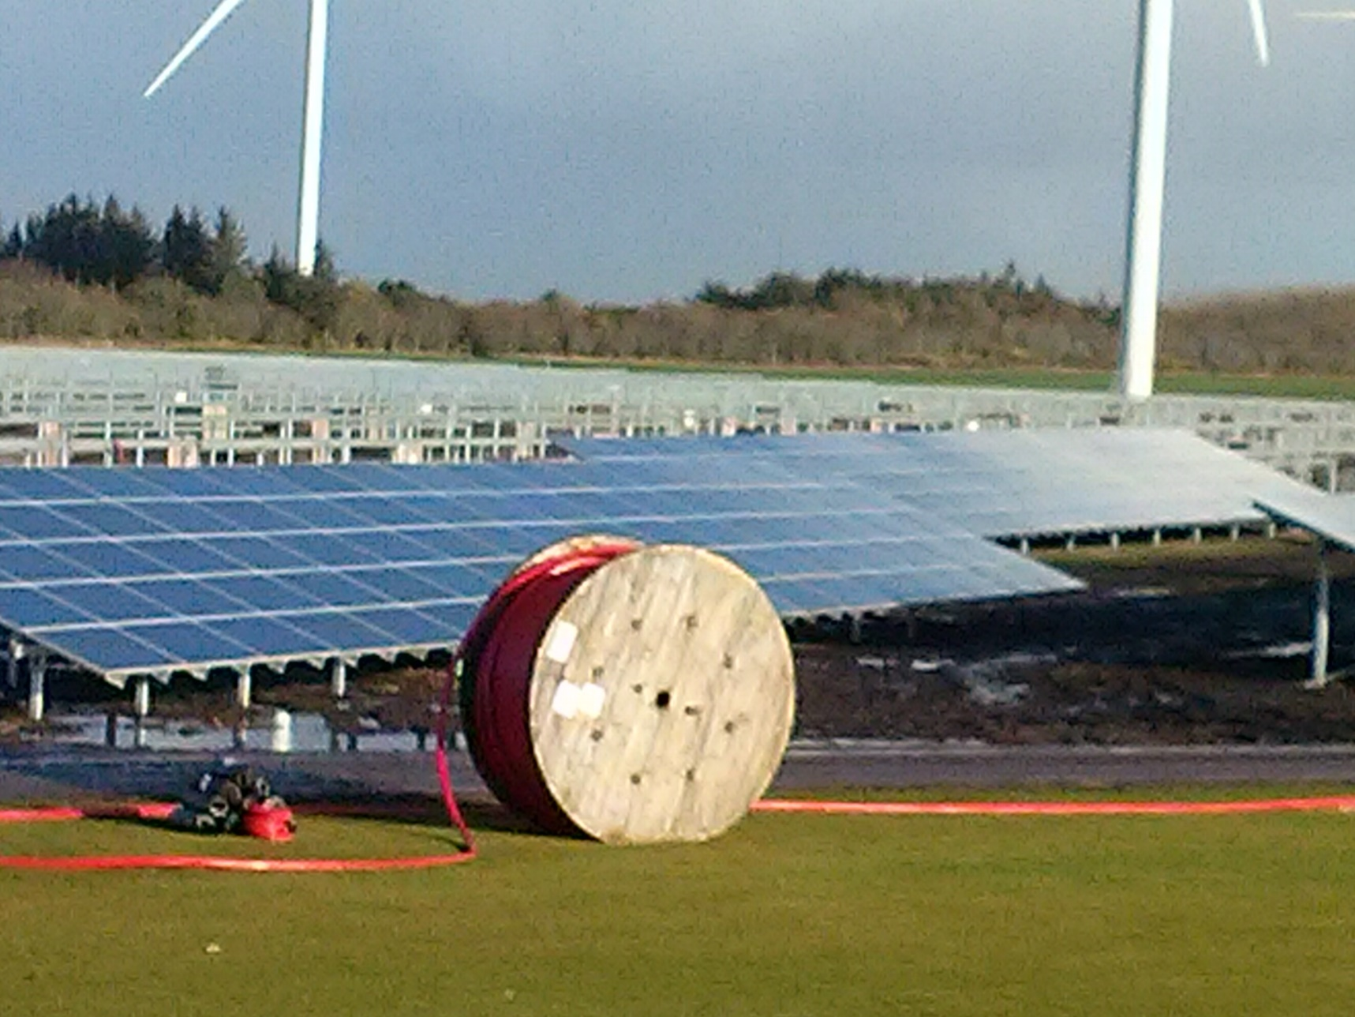

Slide 13
Nørhede-Hjortmose wind farm
22 Vestas-wind mills each 3,3 MW delivered from local factories
Mølleparken kan producere strøm nok til 57.000 husstande. Målt på produktionskapacitet er den Danmarks største.
Investment including 20-years service agreement around 750 mio. kr. -- more than 100 million Euro.
Wind mills was owned 80 pct. by 22 local investors
20 pct. by local citizens living within 4,5 km

Slide 14
SOLAR CELLS PV at Hjortmose
31 km cables and 16,000 poles
10 Investors each hold between 3 and 16 per cent.
69,000 panels spread over 38 transformers
Investment 125 million. kr
Estimated production: ca. 17 million. kWh / year
2.7 per cent. of the municipality's electricity consumption

Slide 15
Solar District Heating (approx.110 plants in Denmark )

Slide 16
Benefits of Community Power
Citizens and communities are involved and make decisions about their energy future. More democracy. People take the POWER.
Stronger, healthier communities are created. Working together in a community and achieving a goal provides a sense of purpose, pride and achievement.
By mobilizing people community energy provides a valuable new source for the much-needed investment in renewables, storage and energy savings.
It raises awareness of locally generated and locally consumed renewable energy as well as promotes efficient use of energy.
This can ensure public support for renewable energy across Europe.

