Slide 1
SCOTLAND
IS A LAND OF ENERGY
OPPORTUNITY
Notes:
Image:
The summit of Ben Aan, overlooking Loch Katrine in Loch Lomond & The Trossachs National Park (Image Credit: Visit Scotland / Kenny Lam)

Slide 2
Local Energy Systems, Community Energy and the Low Carbon Transition Craig Egner European Energy Adviser Scottish Government
Notes:
Delighted to be here in Oldenburg today to profile the Scottish Government approach to promoting Local Energy Systems, Community Ownership and the low carbon transition. In the 20 minutes that I have wanted to
Talk about the policies in place to promote local and community ownership of energy projects and the tools we have to deliver that policy.
But also wanted to give you a sense of the wider context we are operating in, both in terms of tackling climate change as well as dealing with regulatory change in the UK which will have an impact on drivers of community and locally owned renewables.

Slide 3
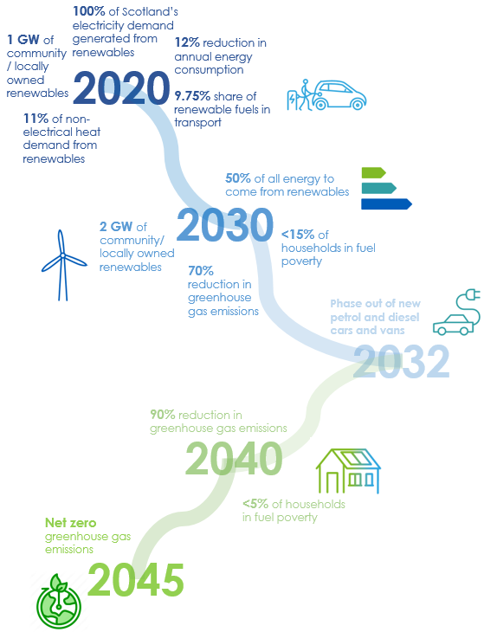
Global climate emergency- Journey to Net Zero by 2045
Notes:
This is the long and winding road to 2045 and to net zero Green House Gas Emissions in Scotland.
In April 2019, the First Minister for Scotland declared a Global Climate Change Emergency and committed to legislating to make Scotland a net zero economy and society by 2045, at the latest. She also committed to making that transition inclusive (ensuring the most vulnerable were not left behind) , to creating opportunities for all and to deliver sustained economic growth.
The 2045 commitment, based on advice from the UK CCC also committed us to interim GHG emission reduction targets of 70% by 2030 and 90% by 2040. And we are currently legislating to bring these targets into domestic law.
But climate legislation isn’t new in Scotland. We passed our first climate act in 2009 , Ministers report to our Parliament annually on annual emission reduction targets and this will continue.
Important to see future policy on local and community energy policy in the context of our climate change commitments,

Slide 4
Developing a system view
Scottish Energy Strategy - Six energy priorities
Consumer engagement and protection
Energy efficiency
System security and flexibility
Innovative local
energy systems
Renewable and low carbon solutions
Oil and gas industry strengths
Notes:
The other driver is our Energy Strategy.
The Energy Strategy launched at the end of 2017 established six strategic energy priorities to help guide the decisions that the Scottish Government, working with partner organisations, needs to make over the coming decades.
It takes a whole-system approach that considers both the use and the supply of energy for heat, power and transport.
Commits us to deriving 50% of our energy from renewables by 2030, that compares to the 32% target agreed by EU energy Ministers

Slide 5
Local Energy Transition
Notes:
So why do we prioritise local energy systems.
Energy system is rapidly decentralising and that trend will continue into the future, That’s in part being driven by the renewables revolution. In Scotland we aim to ensure that 100% of electricity consumption is met from the renewables by the end of 2020. At around 75% by the end of 2018.
So I think this energy trend brings opportunities for community energy.
Scotland has a legacy of strong community engagement in local renewable energy generation which has been supported by the Community and Renewable Energy Scheme CARES which we fund.

Slide 6
Community and Locally Owned Renewables in Scotland: 2018
Community and locally owned renewables, 2018
Capacity of community and locally owned renewables has more than tripled to 697MW in the last six years…
…and there’s approximately 882MW’s worth of projects in the pipeline
Capacity (MW)
Notes:
We believe in targets in the Scottish Government. Can help to drive investment decisions and develop supply chains
Have targets of 1 GW of community and locally owned energy by 2020 and 2 GW by 2030. .
An estimated minimum of 697 MW of community and locally owned renewable capacity was operational in Scotland by the middle of last year, over 18,800 individual installations .
Shared ownership in these local schemes is a key priority. Shared ownership can help promote stronger relationships between local communities and the renewables sector, delivering lasting economic and social benefits to communities across Scotland. Using the planning scheme to ensure that by next year at least half of newly consented projects will have shared ownership.
Historically and given the prevalence of subsidies namely the feed in tariff, the business model was traditionally based on generating an income from a renewable subsidy which would support a community’s longer terms economic and social aspirations. The energy scheme was essentially seen as a revenue generating asset from which the community could glean a benefit,
This is shifting: Important to recognise that the Scottish Government does not hold all the energy policy levers with many aspects reserved to the UK. This is the case with generating subsidies like the Feed In Tariff regime which was closed to new applications in March of this year.
So this means mean that a community’s ability to participate in renewable energy projects is changing.
We are already seeing this shift happen under CARES, with more diverse projects coming forward: ones that involve more complex partnership arrangements with people at a local community level.
There now needs to be a greater focus and priority given to decarbonisation as the driver for community- led action. With other benefits potentially coming from the development of local supply chains and potentially energy and cost savings.

Slide 7
CARES support for local energy covers local ownership and/ or community involvement:
For shared ownership projects
In local energy systems
To contribute to Scotland's 1GW by 2020 target
To maximise
impact from
community benefits
£5m through CARES in 2019/20
Energy Investment Fund provides £20m in 2019/20
Notes:
Community and Renewable Energy Scheme (CARES)
CARES, delivered by Local Energy Scotland on the Scottish Government’s behalf is a one stop shop providing advice and support, including financial support to community groups and organisations and rural SME’s seeking to develop renewable and low carbon projects.
Up to £5 million was available through CARES in 2018/19 to support the growth of community and local energy in Scotland, with the same amount proposed for this financial year.
Energy Investment Fund (EIF)
EIF is a Scottish Government Fund managed and delivered by the Scottish Investment Bank- providing commercial investment for renewables and low carbon energy solutions.
EIF focus is
Increasing community ownership of energy projects in Scotland (including community stakes in commercial developments)
Accelerating the development of commercial low carbon energy projects in Scotland
Up to £20 million was allocated in 18/19 to support investment with the same amount proposed for this financial year.

Slide 8
Other Forms of Assistance
Low Carbon Infrastructure Transition Programme – match funded by EU Structural Funds aimed at providing support to make low carbon projects commercial investor ready.
Energy Efficient Scotland - which aims to make Scotland’s buildings near-zero carbon.
Scottish National Investment Bank - SNIB to be operational during 2020.the Bank’s primary mission will be the “transition to net zero”. Work to shape this is ongoing
Notes:
LCITP - £60 million programme with bulk of funding offered to help innovative projects develop investment grade business cases aimed at attracting private and public finance that will allow the demonstration of innovative technologies at scale.
EE Scotland offers a range of funding instruments to improve the energy efficiency of domestic dwellings in Scotland
SNIB to be operational during 2020 taking over the work . As highlighted within the Scottish Government’s Programme for Scotland 2019-2020, the Bank’s primary mission will be the “transition to net zero”. Work to shape this is ongoing.

Slide 9
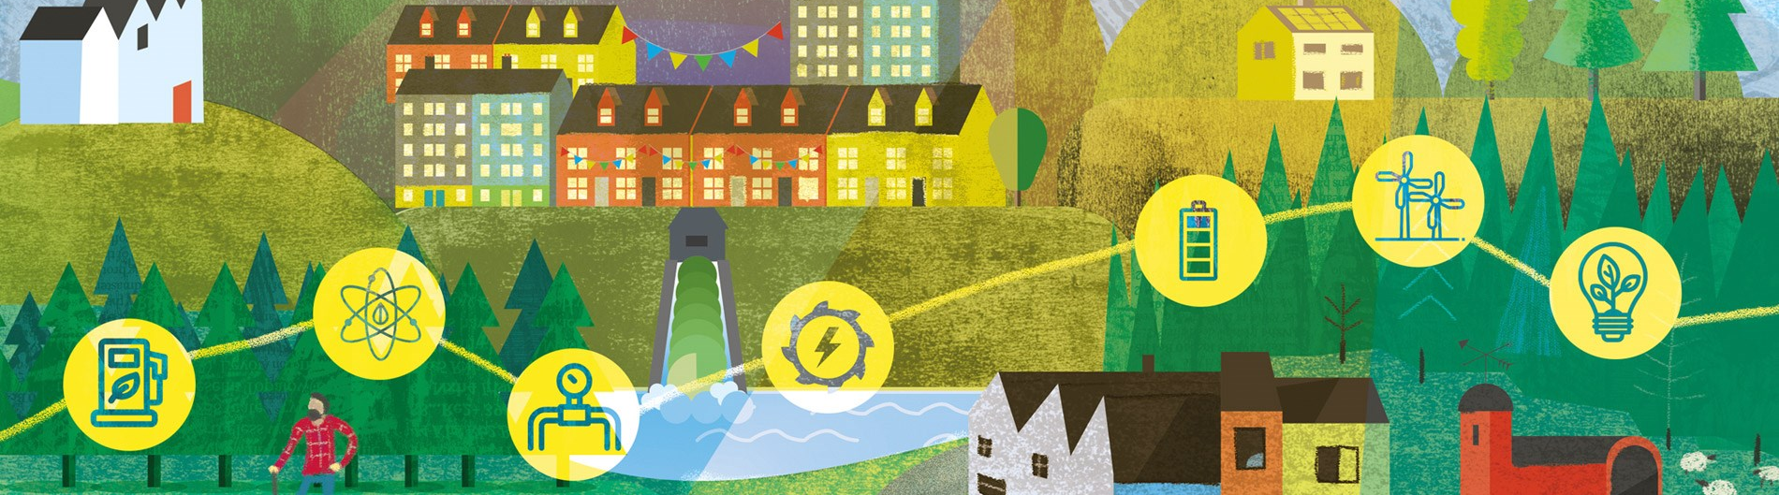
Increasing/MW financial return to community
Increasing community risk and responsibility
100%
LOCALLY
OWNED
SHARED OWNERSHIP
COMMUNITY BENEFIT
from externally owned projects
£100k/ MW £5k/MW
Notes:
Depending on a communities appetite for risk, CARES can provide tailored support.
A number of levels of so called involvement.
Base of the pyramid: supporting a group to access community benefit funding from a commercial developer (as a condition of development),
Middle - taking a share in the asset
Top - supporting a community to develop and own a renewable project.
The higher the risk the potential for increased financial benefit but increasing responsibility.

Slide 10
Stewart Energy – Lesmahagow Development Trust 25%share
Notes:
Shared ownership onshore (2.3 MW) wind project (three turbines) in central Scotland whereby one of the local community organisations has taken a 25% stake with the rural business taking the rest so generating income for business (1200 dairy cows) and income for the community.

Slide 11
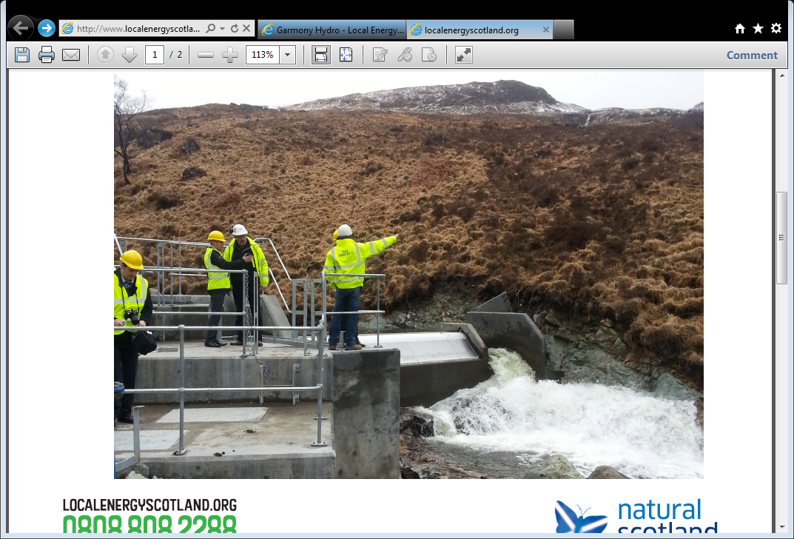
CARES Support – Local Energy Systems Garmony hydro & ACCESS, Mull
Notes:
Example of a scheme fully owned by the community.
400kW hydro instigated by Mull and Iona Community - began generating electricity June 2015
profits will go into the Waterfall Fund.
Virtual district heating to balance the generation - providing cheaper local heat and mitigating grid constraints

Slide 12
Map of community owned projects
Notes:
Each dot is a community owned project so gives you an extent of the scale of coverage

Slide 13
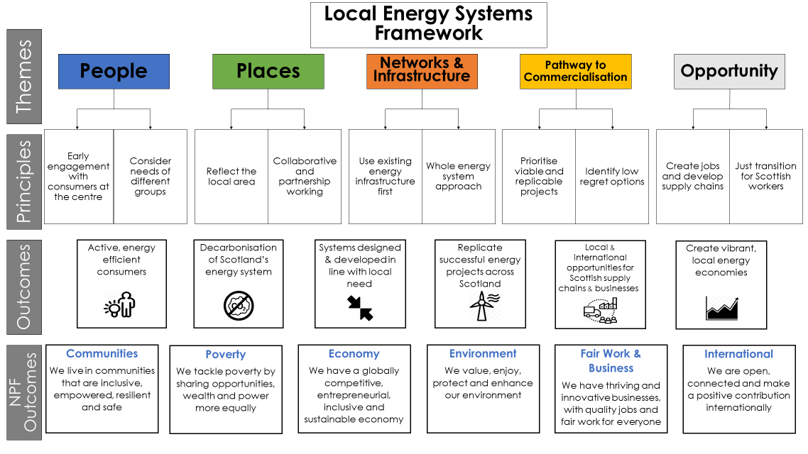
The Future: Local Energy Systems Framework
Notes:
So to look to the future.
As the future of our energy system transitions to a more decentralised one, the Scottish Government considers the time is right to explore with stakeholders across Scotland what values and principles should be embedded in practice and behaviours for everyone who is developing or delivering local energy projects in Scotland,
We will shortly be consulting on a local energy systems policy statement – which will set out a series of key principles and outcomes summarised in this framework
Highlight the following:
Central themes in it will cover people, places, existing infrastructure how to replicate projects and how to ensure economic opportunity
Key outcomes likely to include the need for active energy efficient consumers, decarbonisation being front and centre, local needs based approach, developing projects which are replicable and looking to secure positive impacts for the Scottish supply chain and local economies.
Will are reviewing how CARES can continue support community –led activity in the future changing local energy landscape, this will include ensuring communities have the necessary capacity to capitalise on the opportunities arising from the transition.
I also should close by saying that our local authorities – of which 32 in Scotland – have a major role to play in all of this. We are working with them to put in place a statutory requirement to produce Low Carbon Heat and EE Strategies on how they plan to decarbonise the built environment in their areas and there is an important question of how this joins up with Local Energy Planning. COBN pilots that our Local Energy Scotland colleagues are working on might, if there is time, give active consideration to how we best make this link.

Slide 14
Thanks for Listening! Scottish Government EU Office craig.egner@gov.scot @craigegner1
Notes:
The way we generate, supply and use our energy will change fundamentally in the coming years
It will differ from place to place- based on local need and opportunity.
Our challenge is thus to design a system that facilitates these flexibilities but one that has decarbonisation at its core.
Thank you.

